Slide 1
Driver Education
Program Evaluation

Slide 2
Evaluation Design
Key Questions:
  Is the behind the wheel program filling an otherwise unmet need for our students in an equitable manner?
  What are the strengths and opportunities of the ACPS Driver Education program?
Data Collected:
  Participation data in classroom and in behind-the-wheel
  Crash data from VDOE
  Staff and teacher interviews
  Parent and student survey (very limited participation from students)
Notes:
Driver Education (classroom portion) required for those under 18

Slide 3
Key Findings
The Driver Education program provides a service to the community through its operation and it is a quality program
Although research does not strongly support classroom driver education as lowering crash rates, ACPS crash rates are consistently lower than commercial schools so we should encourage our students to take BTW through an ACPS school and before they are 18
High income students are afforded opportunities to take additional classes because online Health and PE II is offered
Access for low-income students may be challenging and other costs besides tuition (car, insurance) may have larger impact on participation in BTW
Notes:
**emphasize safety with second bullet—of students taking the BTW withus and before they turn 18. There is nothing in VA Code or VDOE curriculum requiring that a multi-car range be used; however, if schools offer behind-the-wheel, a safe space is needed for the initial assessment of students and for students to practice specific skills like off-road recovery.
A multiple-car range (MCR) enables the driver education teacher, from a position outside of the vehicle using electronic or oral communication to teach and supervise several students simultaneously each of whom is operating a motor vehicle at an off-street facility specifically designed for this type of instruction. Range instruction provides basic parking lot skills, such as steering, stopping and accelerating, backing, parking, turning and managing intersecting traffic in a safe environment. The range is also the preferred environment to provide students with simulated emergency and basic evasive driving experiences, such as blocked lane, ABS braking, hydroplaning, and off-road recovery. Albemarle High School has the designated space that is the multi-car driving range located near Jouett. It is fenced in and houses 14 Driver Education vehicles. 9 teachers assigned. The tower on-site also doubles as the office space for most of the Driver Education staff and as storage. The lower floor of the tower has potential for development of a VR lab to provide simulation training. The layout and current usage of AHS makes it challenging for an alternative range placement. The way that the front parking lot is laid out, the amount of traffic, and the proximity to Building Services and LEAD makes it difficult to repurpose any of the front lot for Driver’s Education instruction. The back parking lot might work as an alternative if it was painted and designated, but probably not in its current state.

Slide 4
Background: National Trends in Teen licensing
Graduated Driver Licensing Laws introduced in 1996 attempt to more fully prepare young drivers for the road
National surveys show a downward trend in teen licensing; high school seniors who have a driver’s license dropped from 85.3% in 1996 to 71.5% in 2015
Fewer black, Hispanic, or low-income teens are being licensed before the age of 18
Economic factors primary reason for delayed licensure as well as being able to get around without driving
Notes:
Because extensive research into Driver Education in the early 90s showed little or no reduction in crashes per licensed driver, other means of influencing drivers were introduced. These are the GDL laws that include mandatory education but also restrict driving, restrict passengers, mandate supervised driving and things like that.
Since 1996 there is a downward trend in teen licensing, possibly due to these GDL laws but also possibly due to economic reasons and less motivation to drive--as evidenced by national survey results.

Slide 5
Background: Driver Education Framework in Virginia
Classroom 36 hours
Parent Seminar
45 hours supervised driving
Behind the Wheel Training (7 and 7)
Juvenile licensing ceremony
Earn a permit
Pay fees, pass exam, bring documents, etc.
Must hold permit for 9 months
Economic barrier (no car, insurance)
Lack of interest
Notes:
This evaluation is attempting to provide a picture of the participation data for the aspects of the program that the schools participate in—classroom and BTW. The data is fairly accurate at the start because most students take the 36 hours of classroom driver education in Health and PE II which is a required course. Some students take Health and PE II online and then must take driver education in a different medium—either online or in summer school or through another provider.
Next, students must earn a permit, their parent must attend a parent seminar, and students must at least begin their supervised driving before they attend behind the wheel. After completing behind they wheel, they can earn a permanent license when they have held their permit for 9 months and they attend a licensing ceremony in person. Lack of interest, economic barriers, and potential other reasons may impact student motivation or ability to even reach the BTW course. This data will try to glean some suggestions but should not be taken as absolute. The survey sent to parents and students this fall suggest that students not earning a permit is the primary reason for the lack of progression to behind the wheel. (43% students say not earned permit; 38% parents) 2 students indicated cost and 44 parents indicated cost

Slide 6
Participation Data: Classroom
Notes:
Economically disadvantaged students, Black students and English language learners participate in our program at the highest rates. Black and Hispanic students participate in the class more often than Asian, white, and multi-racial students do. The primary reason that students do not participate in the Health and PE II and therefore Driver Education is that they take the course online instead of in the classroom. The online Health and PE II course is free during the school year but it does not include Driver Education. Driver education must be taken at a cost if the online Health and PE II course is taken or it is not taken at all.

Slide 7
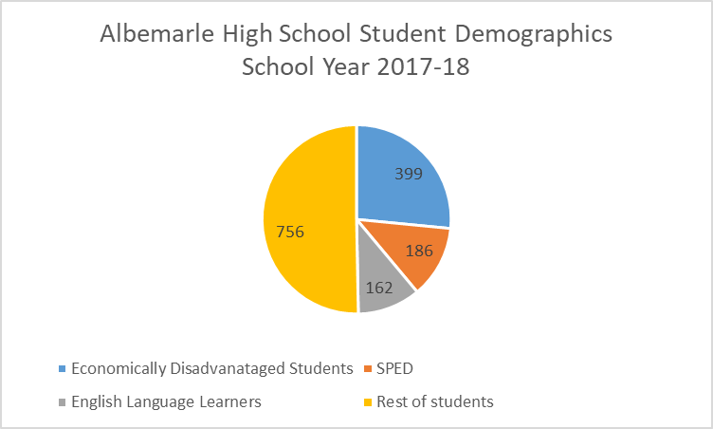
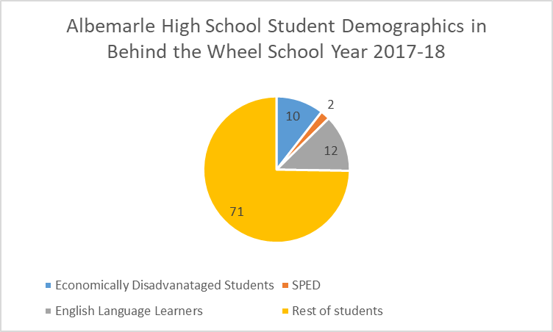
Participation Data: Behind the Wheel compared to AHS Demographics

Slide 8
Crash Data
ACPS “above average” program says VDOE; low crash statistics as a division
Driver Training Schools (commercial schools) consistently have a higher crash percentage ratio
In 3 out of the last 6 years, all Albemarle schools have a lower crash percentage ratio than all other public high schools in VA
In summary, the overall driver education program is more effective than commercial driving schools
Data tables for the last 6 years included in the full report
Notes:
Crash data from VDOE means that they follow the students who Earn a license from the DMV in a certain time period (SY 2015-16). They follow them for one year (2016-17) and then they report out how many had crashes within the first 12 months. The school that is annotated is from where they took the BTW portion of Driver Education. Of note, Albemarle HS trained at least one student from other high schools including MOHS, WAHS, Tandem, Orange County, homeschool students, Charlottesville High School, Blue Ridge School, Monroe (Greene), and Murray.
We believe that there is an error in the coding for this year as we see much more in participation.

Slide 9
Qualitative Data: Staff interviews
Strengths
7 people commented on strong VDOE curriculum
5 people highlighted the experience and professionalism of staff
5 people highlighted the importance of the multiple car range
5 people highlighted leadership of program-specifically Karen Waters-Wicks
Opportunities
6 people said the cost for BTW is too high
4 people noted the shortage of in-car teachers and one noted a shortage of classroom teachers
4 people said to shorten the modules for the classroom portion
3 people noted that the site at MOHS is not ideal for instruction

Slide 10
Parent and Student Survey
Survey sent to all sophomores, juniors, and seniors and their parents in September 2018
69 student respondents and 813 parent respondents
41% of students indicated that they had taken BTW with ACPS or an outside company and 49% of parents indicated the same
43% of students indicated “I have not earned my permit” as the primary reason why they have not taken BTW; 38% of parents indicated the same
Students and parents both answered schedule (“to accommodate my schedule”) as the top reason for choosing either ACPS or an outside company for BTW
11% of parent responders said “cost for behind-the-wheel” was the primary reason for the student not taking it

Slide 11
Recommendations
Ms. Waters-Wicks should review the strengths and opportunities provided from the staff interviews and survey results for potential program modifications
Continue offering both the classroom and the behind-the-wheel Driver Education instruction in our high schools
Waive the fees in whole or in part for those students who cannot afford the fees
  Consider this for the behind-the-wheel tuition
  Consider this for the summer classroom instruction
  Provide funding from Driver Safety fund
Market the program so that students are aware of the effectiveness (over commercial schools) and leverage future high school discussion to highlight driving as a valuable future life skill
Seek opportunities to expand community engagement
Notes:
All are good programs. Nothing to indicate from this type of data what aspects of the Driver Education program are contributing to reducing crash risk.
AHS having the highest attributed to # of students driving to school, driving in a more congested area, students who are not from ACPS fall in that category---can’t be certain though.

Slide 12
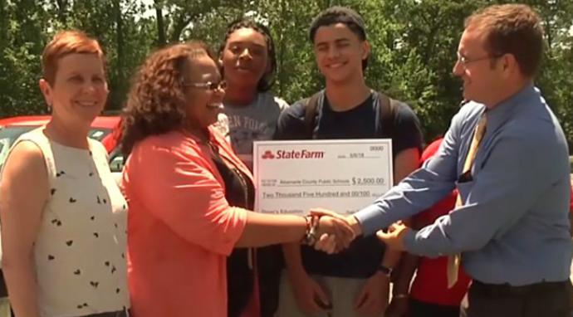
Questions?
Notes:
Western has a range located behind the school and it doubles as a bus parking area and a school bus training area. It is marked with white lines for driver training and also yellow lines for bus parking. There is a small range tower for multi-car use. This means that an instructor will sit in the tower or be on the range while students are driving in the designated space. The students have walkie talkies to hear the instructors commands and another student in the car observing. They are able to coordinate training around the school bus departures in the afternoon with some difficulty. They offer some training during the school day, but they have very limited staff to do so. Cars are parked in designated spaces behind the school and close to the tower. There are 6 teachers assigned to WAHS.

